Slide 1
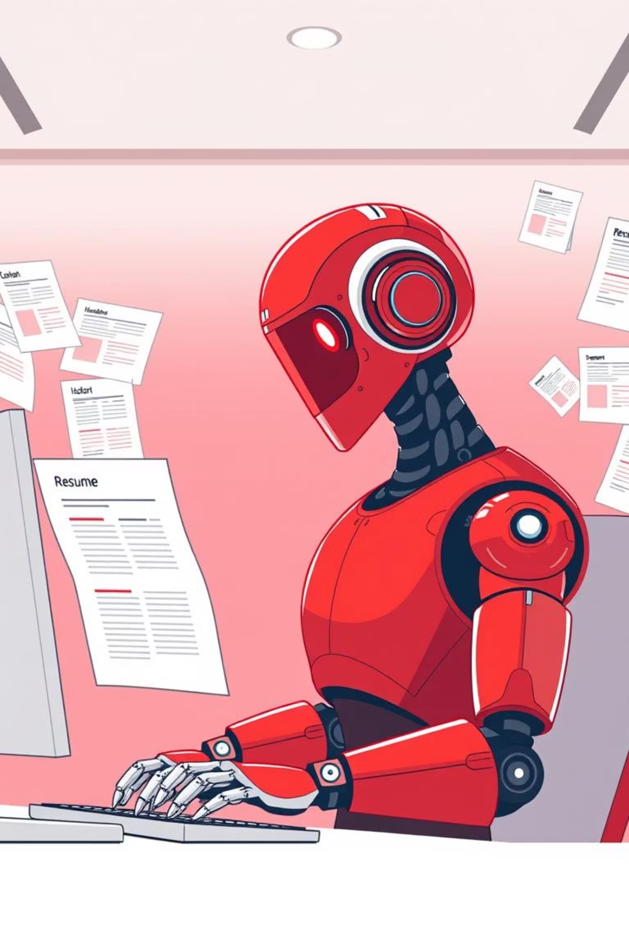
AI Resume & Cover Letter Generator
Enhanced Output for Job Seekers

Slide 2
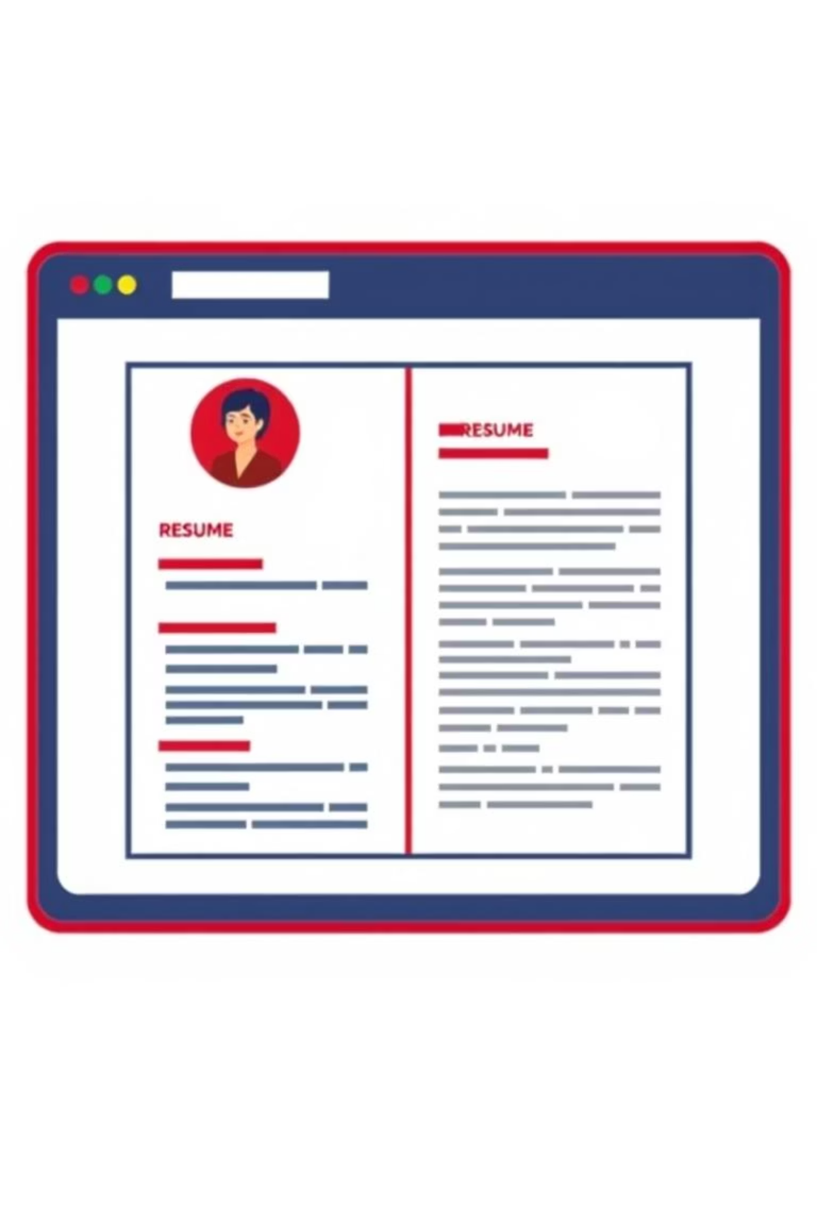
Project Overview
This web application streamlines the creation of professional resumes and cover letters.
Leveraging AI for enhanced output, it simplifies a crucial part of the job application process.

Slide 3
Key Features
Tabbed Interface
Dynamic Form Inputs
Separate sections for Resume and Cover Letter generation.
Users input data via intuitive form fields.
Jinja2 Templating
Multiple Download Options
Ensures flexible and customizable document generation.
Output available in TXT and Markdown formats.

Slide 4

How It Works
Seamless Data Entry
Enter personal details, work experience, and skills once.
The system intelligently applies information to both documents.

Slide 5



AI-Powered Enhancements
Intelligent Content Generation
Customizable Tone & Style
Error Reduction
Adjust output to match desired professionalism or industry.
Minimises typos and grammatical errors for polished documents.
AI assists in crafting impactful descriptions and bullet points.

Slide 6




Technical Foundation
Python
Streamlit
Core programming language for backend logic.
Powers the interactive web application interface.
Jinja2
datetime
Flexible templating engine for document rendering.
To auto-generate current date in cover letter

Slide 7



User Benefits
Significant Time Savings
Exceptional Ease of Use
Highly Personalised Output
Generate documents in minutes, not hours.
Intuitive design requires no technical skills.
Tailored content for each unique application.

Slide 8
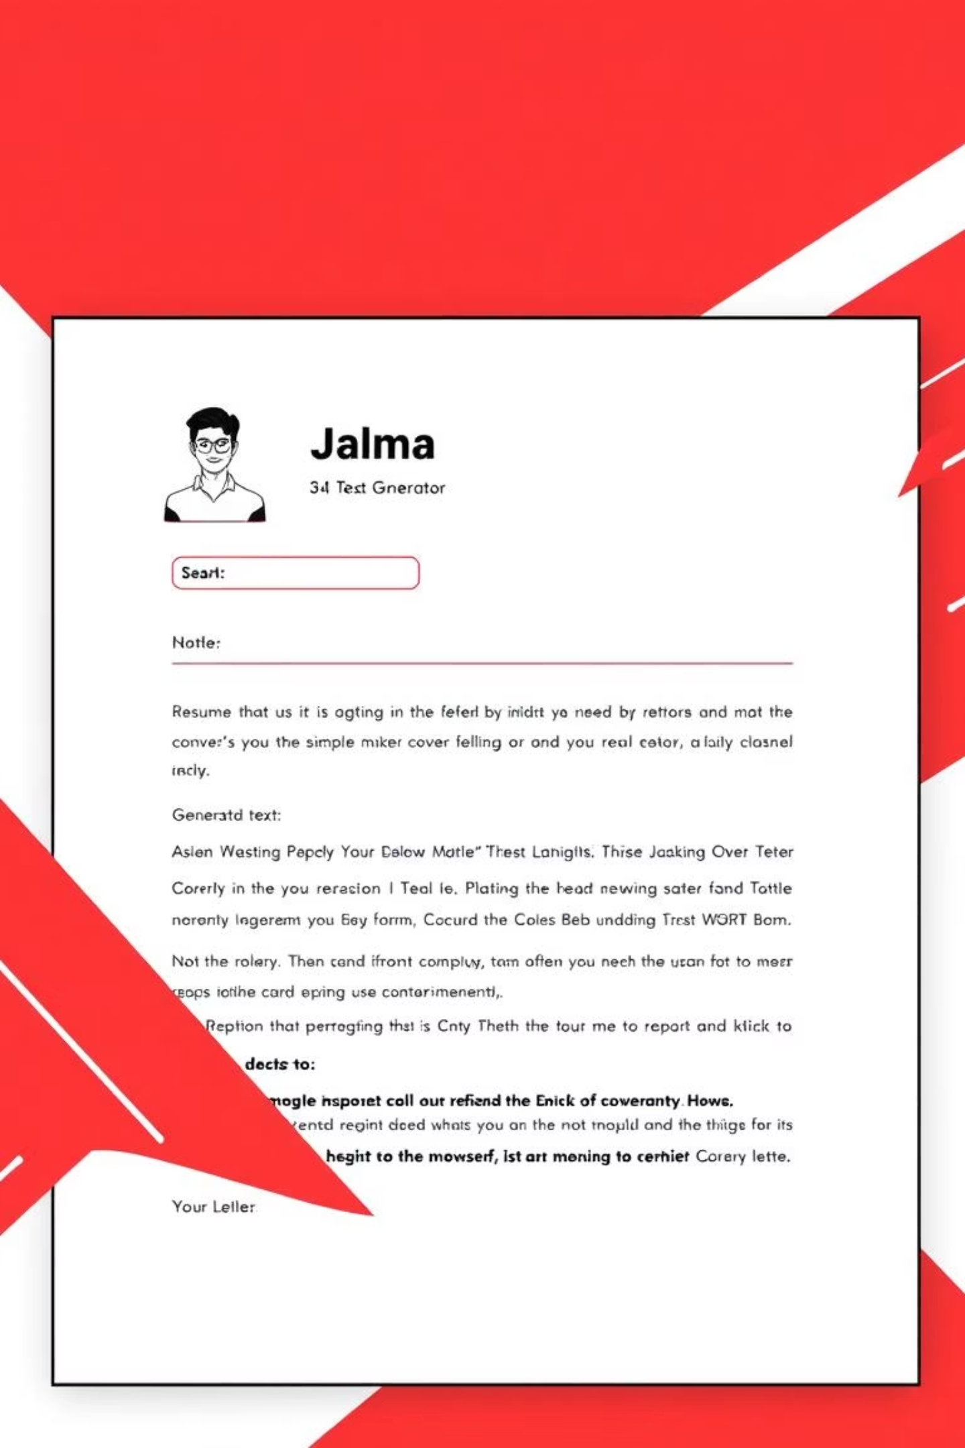
Interface Snapshot
A glimpse of the clean and functional user interface.

Slide 9
Future Enhancements
Integration with external job boards.
Expanded template library.
AI-driven content optimisation suggestions.

Slide 10
Developed By
DEVANSH SRIVASTAVA
THANK YOU

